Slide 1
Spring Cloud Azure
Spring Data
SQL Database
MYSQL
PostgreSQL
Maria DB
Cosmos DB
SQL
MongoDB
Cassandra
Spring Security
Active Directory
AAD B2C
Spring Apps
App Configuration
Event Hubs
Kafka
Service Bus
Redis
Functions
Spring Integration
Service Bus
Event Hubs
Storage Queue
R2DBC
SQL Database
PostgreSQL
MySQL
Spring Messaging
Service Bus
Event Hubs
Zero Trust
Key Vault Secrets
Key Vault Certs
Spring Resource
Blog Storage
Azure Files
Spring Cache
Redis Cache
Micrometer
Monitor
aka.ms/spring-cloud-azure
Notes:
Once your apps are up and running, they can connect with Azure services.
We’ve made it possible to leverage the full power of Azure from your Spring Boot Apps, and it’s getting easier to do so every day.
We provide mechanisms to connect and interact with data, messaging, cache, storage, directories, and so much more.

Slide 2
Azure Spring Apps in a nutshell
Developers Easily build and deploy
IT Operators Simple to operate at scale
Executives Peace be with you!
Build and scale distributed workloads at cloud scale.
Externalize config, enable service registry, secure, automate end-to-end, and monitoring.
Harness the power of K8S without learning or operating it.
Easy to spawn environments.
Automate testing.
Advance to production across the globe.
Home for distributed workloads that leverage services on Azure, on-premises, and externals.
Eliminate middleware management efforts – say patching, running middleware, etc.
Unlimited scale without additional hardware procurement or datacenters.
Define roles and responsibilities to match your team structure – Azure RBAC (developer, DevOps, SRE, tester, security).
Monitor end-to-end – detect and react faster.
Automate end-to-end.
Implement charge backs in line with your funding model – through Azure cost management system.
Minimize costs.
High availability through unpredictable volumes and recover faster from failures.
Expand across the globe – 60+ Azure regions with speed and scale to meet your needs.
Strengthen your security posture with Azure.
Supported by Microsoft and VMware.
Notes:
In brief – There is something for everyone.
If you are a developer – you can:
Build and scale workloads at cloud scale, you can easily apply cloud-friendly patterns such as externalized configuration, service registration, and discovery, automating and monitoring end-to-end.
Get the full power of K8S without touching it.
Create any number of environment, automate testing and advance to production across the globe.
If you are in the IT team – you can:
Operate the service and environments at scale:
The service becomes the home for distributed workloads; you can connect with services running on Azure or on-premises or anywhere.
As you operate, you do not have to worry about middleware management.
Get unlimited scale.
Align your team’s roles and responsibilities to match your team structure using Azure RBAC
Apply policy management.
Monitor and automate end-to-end.
Also, implement charge-backs in line with your funding model.
If you are an executive:
You have the essential need to minimize total cost of ownership, high availability, and plenty of head room to grow the workload.
You can harden your security using Azure’s security and be fully supported by Microsoft and VMware.
© 2022 VMware Inc. and Microsoft Corporation. All rights reserved. MICROSOFT MAKES NO WARRANTIES, EXPRESS, IMPLIED OR STATUTORY, AS TO THE INFORMATION IN THIS PRESENTATION.

Slide 3

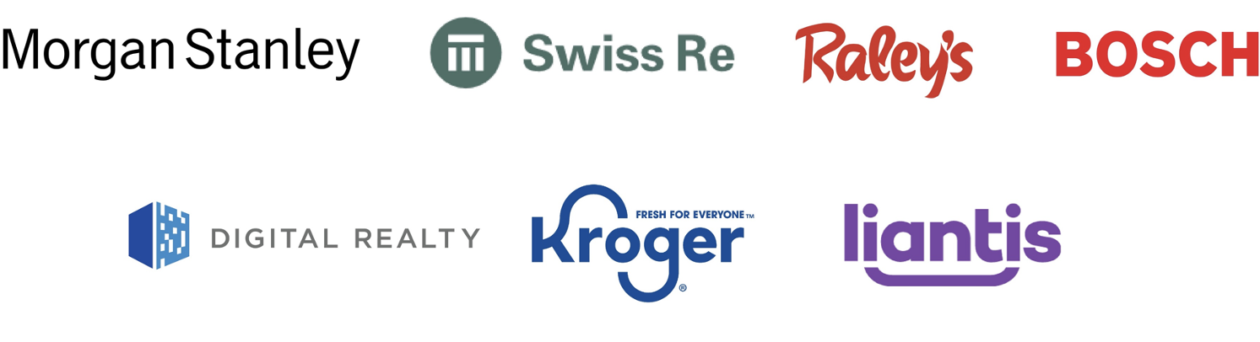


Azure Spring Apps Home for enterprise Spring Boot applications
Notes:
Enterprises are running their mission-critical Spring Boot applications at scale on Azure. <PAUSE>
With Azure Spring Apps, you get auto-scaling, app management, auto patching, ease of monitoring, and many more rich platform features.
© 2022 VMware Inc. and Microsoft Corporation. All rights reserved. MICROSOFT MAKES NO WARRANTIES, EXPRESS, IMPLIED OR STATUTORY, AS TO THE INFORMATION IN THIS PRESENTATION.

Slide 4

Azure Spring Apps Enterprise
Notes:
Now, you get more with Azure Spring Apps Enterprise.

Slide 5
Azure Spring Apps Enterprise
Ship faster with VMware Tanzu components
Unlock Spring’s full potential with VMware Spring Runtime Support
Notes:
Enterprise is the new tier and is generally available.
Enterprise delivers even more productivity, and you can leverage Spring experts to make your projects even more successful.

Slide 6
Ship faster with VMware Tanzu components
Build packs with app integrations
Management of app container creation
Out-of-the-box SSO with any identity provider
Out-of-the-box throttling and caching
Accelerators for hardening app config and best practices
Cloud-native streaming and batch data processing pipelines
….
Build Service
Application Configuration Service
Service Registry
Spring Apps Gateway
API portal
Application Accelerator
Application Live View
Spring Apps Data Flow*
….
*Roadmap is not confirmed and subject to change.
Notes:
Tanzu components provide new capabilities designed for enterprises running Spring applications at scale.
Today, we will show you some of these features.

Slide 7



Deploy and manage Spring and polyglot applications.
Notes:
You can deploy and manage Spring and polyglot applications built using Node, Python, Go, and .NET.
© 2022 VMware Inc. and Microsoft Corporation. All rights reserved. MICROSOFT MAKES NO WARRANTIES, EXPRESS, IMPLIED OR STATUTORY, AS TO THE INFORMATION IN THIS PRESENTATION.

Slide 8
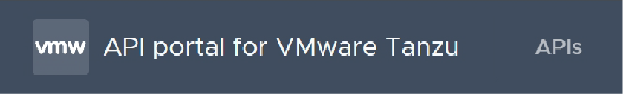

Effortlessly route client requests to apps.
Notes:
With the fully managed Spring Apps Gateway, you can route any requests to apps and address cross-cutting considerations for those apps behind the gateway.
Cross-cutting considerations like configuring single sign-on for end users using your preferred identity provider, including Azure Active Directory or considerations like request rate limiting, and many more features like these.
© 2022 VMware Inc. and Microsoft Corporation. All rights reserved. MICROSOFT MAKES NO WARRANTIES, EXPRESS, IMPLIED OR STATUTORY, AS TO THE INFORMATION IN THIS PRESENTATION.

Slide 9
Azure Spring Apps Enterprise 99.95 SLA
Ship faster with VMware Tanzu components
Unlock Spring’s full potential with VMware Spring Runtime Support
Notes:
Let’s talk about support.

Slide 10
Unlock Spring’s full potential
with VMware Spring Runtime Support
AspectJ
Micrometer
Reactor
Spring AMQP
Spring Batch
Spring Boot
Spring Apps Commons
Spring Apps Config
Spring Apps Netflix
Spring Apps Bus
Spring Apps Cloud Foundry
Spring Apps Open Service Broker
Spring Apps Consul
Spring Apps Security
Spring Apps Sleuth
Spring Apps Zookeeper
Spring Apps Kubernetes
Spring Apps CLI
Spring Apps OpenFeign
Spring Apps Gateway
Spring Apps Function
Spring Apps Contract
Spring Apps Task
Spring Apps Stream
Spring Apps Stream Binder for Apache Kafka®
Spring Apps Stream Binder for RabbitMQ
Spring Apps Stream Binder for Kafka Streams
Spring Apps Vault
Spring CredHub
Spring Data for Apache Cassandra™
Spring Data Commons
Spring Data KeyValue
Spring Data LDAP
Spring Data JDBC
Spring Data JPA
Spring Data MongoDB
Spring Data GemFire
Spring Data For Apache Geode™
Spring Data Redis
Spring Data Rest
Spring Data Solr
Spring Framework
Spring HATEOAS
Spring Integration (Core Modules + Kafka)
Spring For Apache Kafka®
Spring LDAP
Spring Kerberos
Spring Rest Docs
Spring Retry
Spring Statemachine
Spring Security
Spring Security OAuth
Spring Security SAML
Spring Apps Data Flow
Spring Session
Spring Session for MongoDB
Spring Session for GemFire/ Apache Geode™
Spring Tool Suite
Spring Tools 4
Spring Vault
Spring Apps Skipper
Spring Apps Stream/ Task App Starters
Get 24/7 support
Notes:
Support and expert guidance for Spring projects let you develop and deploy applications faster.

Slide 11
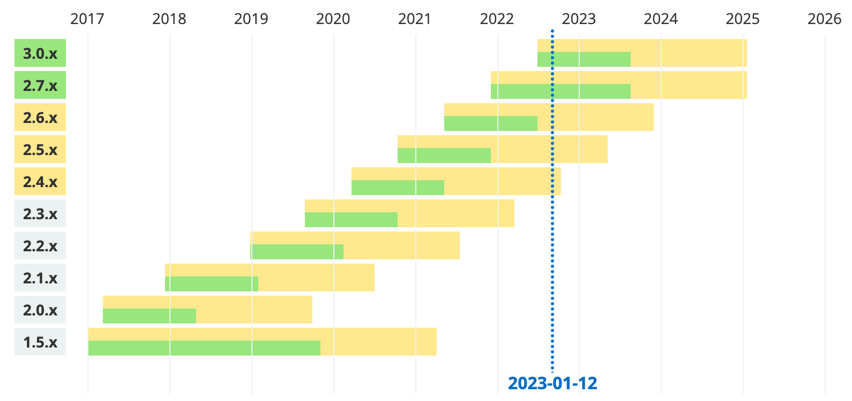
Commercial support for Spring Boot
Legend
 | OSS support |  | Commercial support |  | Future release
 | Free security updates and bugfixes with support from the Spring community. |  | Business support from Spring experts during the OSS timeline, plus extended support after OSS End-Of-Life. Publicly available releases for critical bugfixes and security issues when requested by customers. |  | Generation not yet released, timeline is subject to changes.

Slide 12



FedEx Customer Story
“FedEx launched a Global Delivery Prediction Platform that dynamically predicts estimated time of arrival on more than 16 million shipments a day.
We integrate these machine learning-based insights back
into our core systems to optimize our operations and to give
our customers greater visibility than ever before. Exposure and consumption of these insights is critical, and we chose Azure Spring Apps as our principal compute for high-volume processing because of its ease of use, scale, and integrations into the Azure ecosystem.
Our collaboration with Microsoft and VMware has delivered an amazing service for fast-moving Java teams to deliver impactful solutions for our customers.”
−Tony Kreager Senior Vice President, Data Engineering and Data Science FedEx Dataworks
Learn more here: https://aka.ms/FedEx

Slide 13


Swiss Re Customer Story
“The Azure Spring Apps allows our teams to build new business services rapidly, as the platform and underlying infrastructure is fully managed. The platform is integrated with the Azure ecosystem, which enables us to achieve the desired level of automation and means to operate the services securely. Now that we have the first set of services running in production, it is all about doing more of the same using the Azure Spring Apps to meet our critical delivery deadlines.”
−Nicolas Andres Head IT Group Finance Program Swiss Re Management Ltd. (Switzerland)
Learn more here: https://aka.ms/swiss-re
Notes:
Swiss Re is the world’s largest reinsurance company.
They’ve been in business for over 150 years.
Swiss Re wants to build their business services rapidly without worrying about the underlying infrastructure or Kubernetes. At the same time, they would like to instill a Zero Trust model through simple architecture and full-scale automation.
They rely on Azure platform services.
The Azure Spring Apps Platform as a Service arrived at the right time and fitted Swiss Re’s strategy to concentrate on more abstracted infrastructure. Azure Spring Apps hosts what they call mini-services, which perform functions, such as the definition and execution of rules, management of financial data models, and validation of financial data.

Slide 14
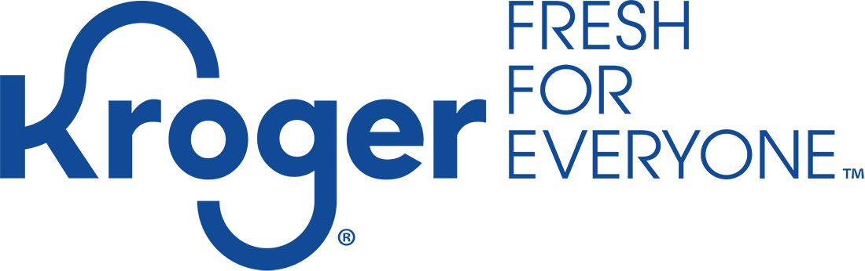
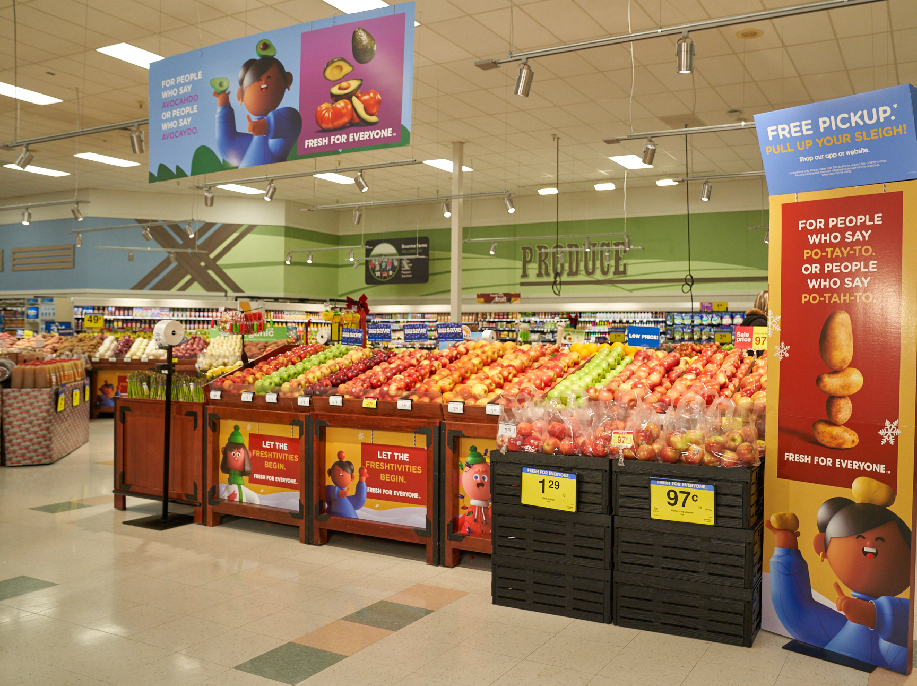
Kroger Customer Story
“I talk about our move to the cloud like this − imagine if you’re pulling into a racetrack pitstop and instead of changing the tires, you had to change out the whole engine. And in making the switch to Microsoft Azure, we changed out that engine − literally − overnight.”
−Doug Wilson Senior Director of Software Engineering Kroger
Learn more here: https://aka.ms/kroger-on-azure

Slide 15


Morgan Stanley Customer Story
“We leverage Spring frameworks for most of our development, and Azure Spring Apps is at the heart of our strategy for implementing Global Securities Settlement platform. Azure Spring Apps makes it very easy for us to configure, deploy, monitor, and scale our Spring Boot applications. Built-in application lifecycle management, ease of automation, and ease of monitoring enables us to scale our development team without compromising code quality and robustness of our applications. Azure Spring Apps is at the heart of our platform.”
−Dhiren Shah Distinguished Engineer and Executive Director Morgan Stanley
Learn more here: https://aka.ms/Morgan-Stanley

Slide 16


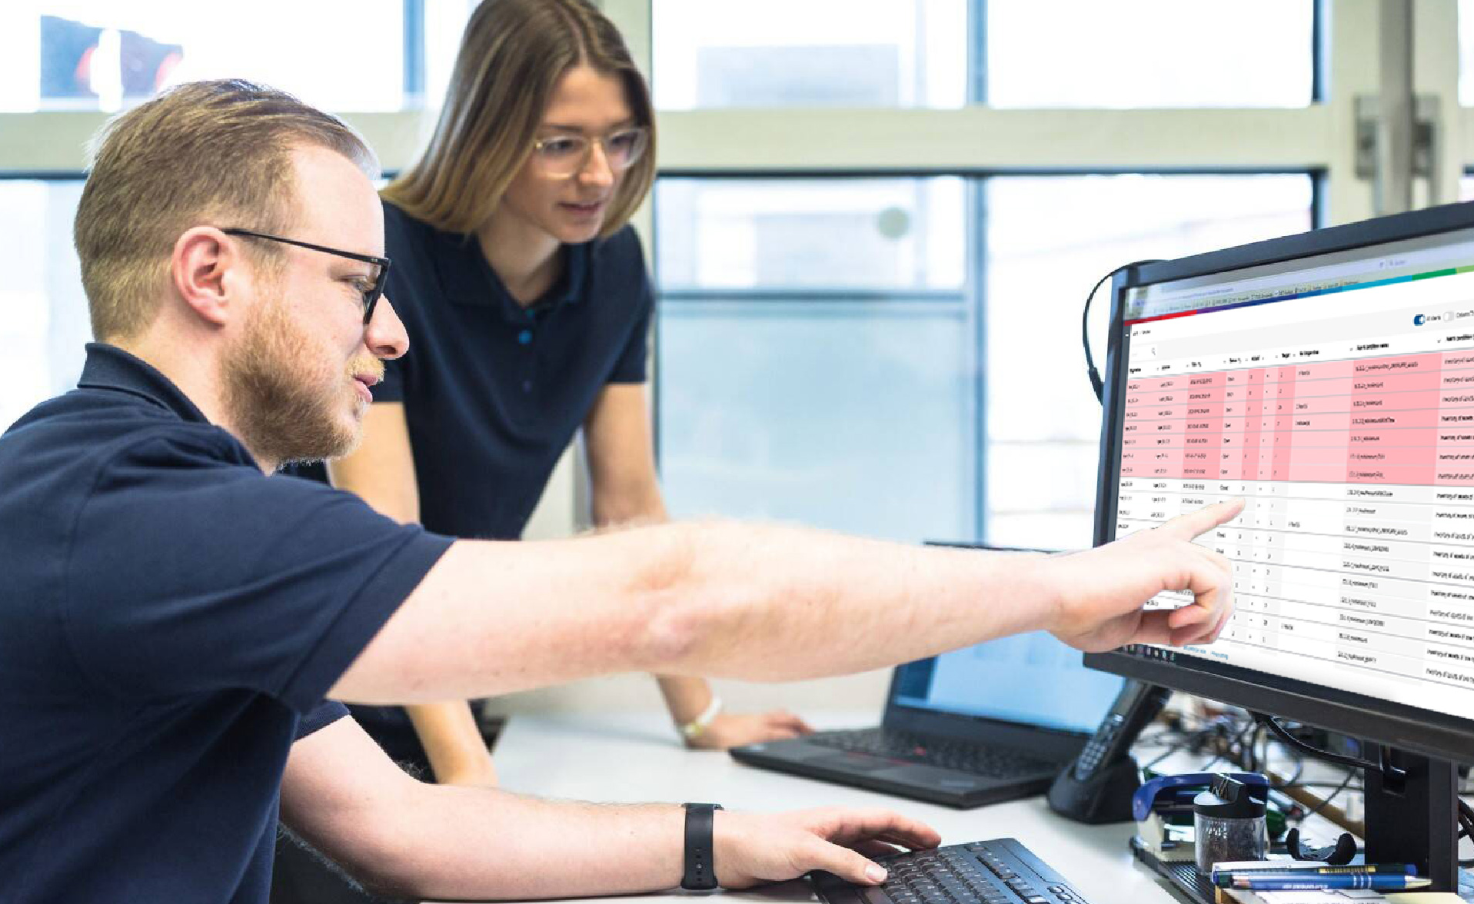
Bosch Customer Story
“We are Java developers. We are not infrastructure guys. We are not system administrators. With Azure Spring Apps, we don’t have to worry about managing Kubernetes or cluster downtime.”
−Philipp Stussak Software Architect Bosch
Learn more here: https://aka.ms/Bosch.IO

Slide 17

Demo 1 Jar to URL
Create service
1
az spring create --name ${SPRING_CLOUD_SERVICE} \ --sku standard \ --resource-group ${RESOURCE_GROUP} \ --location ${REGION}
2
Create app
az spring app create --name ${CUSTOMERS_SERVICE}
15 mins
Deploy app
3
az spring app deploy --name ${CUSTOMERS_SERVICE} | --jar-path ${CUSTOMERS_SERVICE_JAR}
4
View logs
az spring app logs –f --name ${HELLO_WORLD}
5
Scale app
az spring app scale -n ${HELLO_WORLD} \
--instance-count 3
Notes:
Speaker: Adib

Slide 18
Workshop Setup
Launch GitHub Codespaces
Prepare your dev environment
Log into Azure – Portal and CLI
Open Azure Spring Apps Enterprise
https://aka.ms/main-door
20 mins

Slide 19
Lab 1 Deploy Hello World!
Create Hello World app
Run locally
Deploy to cloud
View logs
Scale app
Clean up
30 mins

Slide 20
Simpler build and deploy
15 mins
Notes:
Speaker: Adib

Slide 21
Dockerfile: Most common way of creating containers
Popular and easy to get started
DOCKERFILE TO CREATE JVM
Good starting point
Descriptive file specification
Flexibility is their power
Notes:
When you think about containerizing an application, you probably think about writing a Dockerfile.
Dockerfiles are flexible, allowing you to control every aspect of the container image, including the OS, middleware, and the command to run the applications.
While a Dockerfile is a nice single point of assembling an application, they become problematic once you scale the usage of Dockerfiles across many applications and many teams in a large enterprise.
Let’s look at the scaling challenges and see how we can solve them.

Slide 22

Containers built using Dockerfile are hard to productionize and scale
When dev teams build images differently, they introduce vulnerabilities and complexity
My app 1
Broken build
Problem
Image updates Hard to debug, fix, and maintain non-standard images across the fleet
Security posture Challenging to keep container images free of vulnerabilities
Full stack container audits Hard to uniformly track container dependencies
IT governance Hard to reinforce software compliance
JDK I found
Trusty OS
Unverified update
Hard to track and patch CVE
My app 2
Trusted JDK
ubuntu
Out of compliance
My app 3
Trusted JDK
CentOS
Notes:
Imagine your have 25 dev teams building and maintaining applications. Each team might choose to write their Dockerfile in a slightly different way, for example, different teams might pick different base OS images
or different distributions of the JDK to use. Without standardization across all teams, you will run into the following problems:
Image updates are hard. The only way to update an image is to edit the Dockerfile that the image is based on and re-run the build. This means that you need to know and understand what is in the Dockerfile and why it is there to determine if a change is safe to perform or not. If a critical security vulnerability is discovered in a container image, for example in library such as openSSL or Log4j where it is urgent to upgrade to a new version. You will need to track down every single dev team, ask them to modify the Dockerfiles they created to upgrade the image with the latest security patch. There is no easy button that a central team can press and automatically update all containers across all environments in minutes.
Security posture is negatively affected. When each team writes their down Dockerfile, it is easy for a team to accidentally pick an insecure dependency or configure the container image in an insecure way. It will be hard to track where CVEs are located in container images and perform the operations to fix them.
Full stack container audits are hard. If you are in a regulated industry, such as banking, or sell your solutions to governments, you might have to perform full stack audits of containers that deploy to production. If everyone writes their own Dockerfile, the audit tasks might be quite hard.
You can impose IT Governance rules to review the Dockerfiles created by each team and try to drive consistency and security best practices across all container images. However, these manual reviews will slow down dev team velocity and introduce significant delays into the process of having an idea and getting that idea into production.
Bottom line is that Dockerfiles are very powerful and too low level for application developers to use. For code that we write, we can use a higher-level abstractions than Dockerfiles.

Slide 23
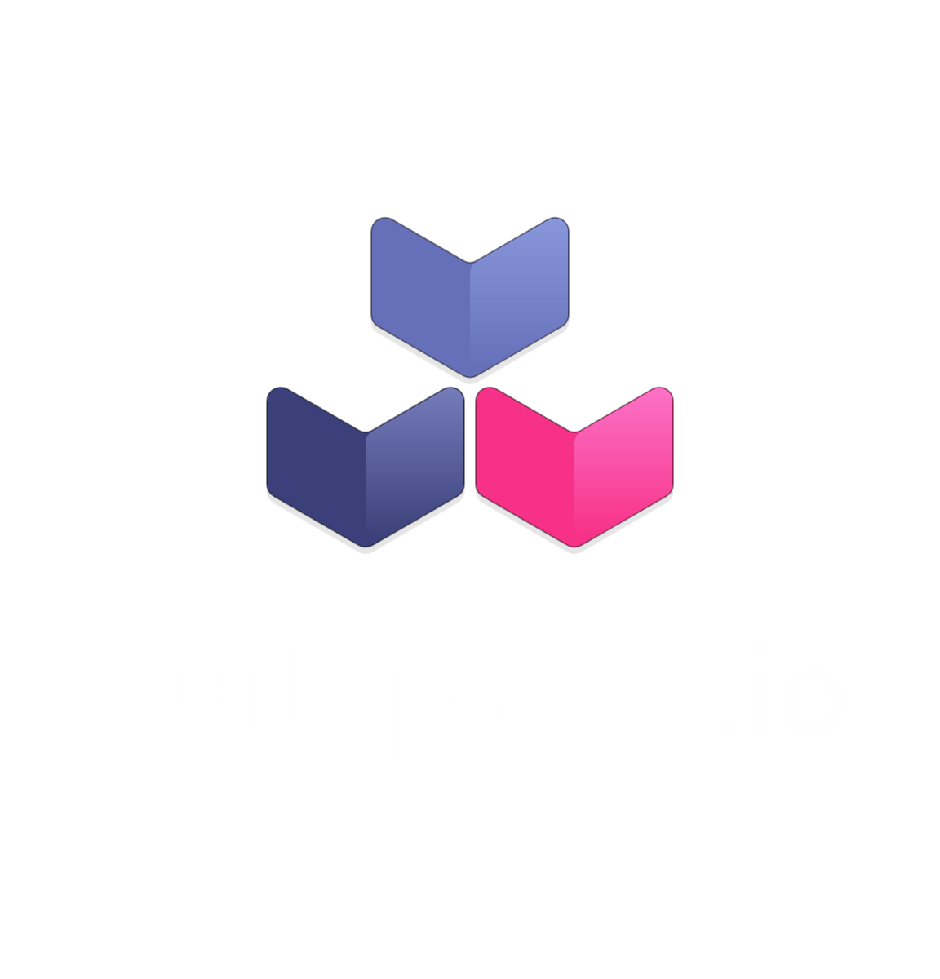
Cloud Native Buildpacks
Specification to translate application code to OCI-compliant container image
Source Code
Cloud Native Buildpacks
OCI Container
Notes:
Cloud native buildpacks (CNBPs) are the higher-level abstraction for containerizing source code produced by dev teams.
So, what is CNBP? It is purely a specification project to turn applications into OCI-compliant containers. It consists of buildpacks, which is an object that scans the source code to determine what type of programming language the code is written in, identifies what middleware dependencies the code requires, then creates an OCI image using all the best practices for security, and containerization.
The developer does not need to write a Dockerfile, they just need to focus on writing application code.
Cloud-native buildpacks make it easy to go from source code to OCI-compliant containers. They:
Drive consistency.
Create a mechanism to separate developer concerns from operational maintenance and security.
Build on years of experience running millions of containerized workloads at scale.
CNBPs provide a centralized easy button to automatically and safely upgrade all the container layers below the application code without having to go back to the dev team that wrote the code. For example, if you have 1,000 containers running on a specific version of JDK and a JDK vulnerability is discovered, you can patch all 1,000 containers with a single command. Thus, allowing to increase security.
CNBPs allow developers to configure them using high-level settings, for example, a developer can tell the buildpack that the application should run on a specific major version of Java (such as Java 11) or a specific version of Node (such as Node 16.x), and the buildpack will automatically pick the most recent secure version of the language runtime that meets the developer’s requirements.
Admins can patch all the layers below the application automatically without breaking applications.
We work with CNBP. We get speed and safety.

Slide 24
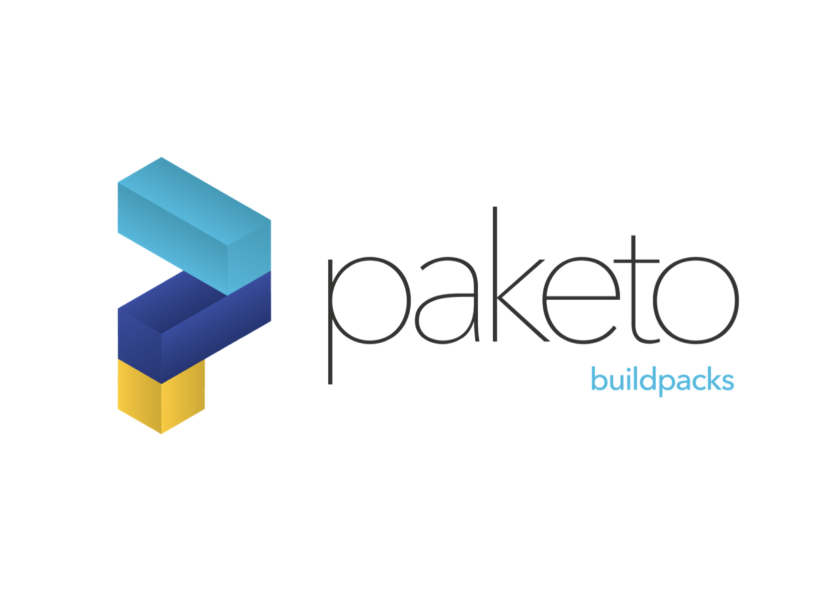



Buildpacks ecosystem
Open Source Buildpacks
Enterprise Ready Buildpacks
Buildpacks
All popular languages and frameworks supported
Notes:
Buildpacks are a CNCF specification and there many different implementations of these buildpacks:
VMware sponsor the development of the paketo OSS buildpacks,
the pakaeto buildpacks implement the buildpack specification for all popular programming languages suc as Java, .NET, Node … etc.
VMWare Tanuz create a set of enterprise ready commercial buildpacks based on Paketo that have long term support and meet all the stringest security and compliance requiremnets that enable enterprise to meet regulatory constraints.
On Azure Spring Apps Enterprise you have access to all the VMWare enterprise ready buildpacks

Slide 25
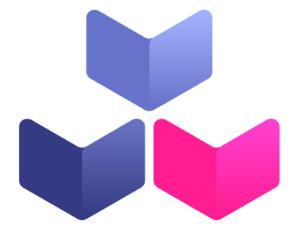



Cloud Native Buildpacks
Specification-only project that transforms application code to images that can run on any cloud
Source Code
Cloud-Native Buildpacks
OCI Container
Open Source Buildpacks + Build Platform
app
dependency
kpack
run image
Enterprise-ready Buildpacks + Build Platform
Buildpacks
Build Service
Kubernetes
Public Clouds
Notes:
In order to get the most value out of buildpacks and the best developer experience, VMware created an OSS project called kpack that allows you to run buildpacks inside a K8S cluster. You can point kpack at a source code, Java app, or a .jar file, and it will produce a container image. Think of kpack as an implementation of the Cloud-Native bulidpack specs that take source code and turn it into a container.
Kpack is an Open Source project and VMware Tanzu Build Service is the commercial version of the kpack OSS project.
In summary, when you deploy an application to ASC-E enterprise, you only have to write app code, you don’t have to worry about containerizing your application because the Tanzu Build Service and Tanzu buildpacks will take your source code and apply all the containerization best practices to produce a hardened, optimized container image.
Let’s take a tour of how ASC-E uses buildpacks.

